Slide 1

JS Design Patterns
Following Best Practices
SoftUni Team
Technical Trainers
Software University
http://softuni.bg

Slide 2
Table of Contents
What is a Pattern?
Common Design Patterns
Factory pattern
Decorator pattern
Façade pattern

Slide 3

Design Patterns
Definition and Structure

Slide 4
What is a Pattern?
Recurring solutions to design problems you see over and over
Constitute a set of rules describing how to accomplish certain tasks
Design patterns focus more on reuse of recurring architectural design themes
Frameworks focus on detailed design and implementation

Slide 5
Categories of Design Patterns
Design Patterns can be broken down into a number of different categories:
Creational
Structural
Behavioral

Slide 6
Creational Design Patterns
Focus on handling object creation mechanisms
These patterns control the creation problems
Some of the patterns that fall under this category are:
Constructor
Factory
Prototype
Singleton

Slide 7
Structural Design Patterns
Focus on object composition
Ensure that when one part of a system changes, the entire structure of the system doesn't need to do the same
Some of the patterns that fall under this category are:
Decorator
Facade
Adapter
Proxy

Slide 8
Behavioral Design Patterns
Focus on improving or streamlining the communication between disparate objects in a system
Some of the patterns that fall under this category are:
Iterator
Mediator
Observer
Visitor

Slide 9
Benefits of Design Patterns
Inspiration
Patterns don't provide solutions, they inspire solutions
Patterns explicitly capture expert knowledge and design tradeoffs
Patterns improve communication
Pattern names form a vocabulary
Design patterns enable large-scale reuse of software architectures

Slide 10
Drawbacks of Design Patterns
Patterns do not lead to direct code reuse
Patterns are deceptively simple
Teams may suffer from patterns overload
Integrating patterns into a software development process is a human-intensive activity

Slide 11

Factory Pattern

Slide 12
The Factory Pattern
Main purpose - creation of objects
Use when
a class can't anticipate the class of objects it must create
a class wants its subclasses to specify the objects it creates
classes delegate responsibility to one of several helper subclasses

Slide 13
Pros and Cons
Pros
Compatible products
You avoid tight coupling
Single Responsibility Principle
Open/Closed Principle
Cons
The code may become more complicated than it should be

Slide 14
Example
function Employee(name) {
this.name = name;
this.say = function () {
console.log(`I am ${name}`)
};
} function EmployeeFactory() {
this.create = function (name) {
return new Employee(name);
};
}
//Continues on the next slide

Slide 15
Example (2)
let people = [];
let employeeFactory = new EmployeeFactory();
people.push(employeeFactory.create("Joan Peterson"));
people.push(employeeFactory.create("Tim O'Neill"));
people.forEach((person) => {
person.say();
})

Slide 16

Decorator Pattern

Slide 17
The Decorator Pattern
Lets you attach new behaviors to objects
Uses
For adding responsibilities to individual objects dynamically and transparently
For responsibilities that can be withdrawn
When extension by subclassing is impractical

Slide 18
Pros and Cons
Pros
Alternative to subclassing for extending functionality
Supports the principle that classes should be open for extension but closed for modification
Cons
Many small objects in our design
Can cause issues if the client relies heavily on the components concrete type
Can complicate the process of instantiating the component

Slide 19
Example
let User = function (name) {
this.name = name;
this.say = function () { console.log("User: " + this.name); };
} let DecoratedUser = function (user, city) {
this.user = user;
this.name = user.name; // ensures interface stays the same
this.city = city;
this.say = function () {
console.log(`Decorated User: ${this.name}, ${this.city}`)
};
}
//Continues on the next slide

Slide 20
Example
let user = new User("Kelly");
user.say();
let decorated = new DecoratedUser(user, "New York");
decorated.say();
User: Kelly
Decorated User: Kelly, New York

Slide 21

Facade Pattern

Slide 22
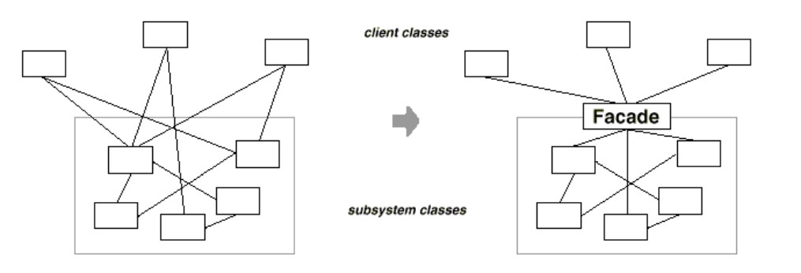
The Facade Patters
Widely used in the JavaScript libraries
Provides an interface which shields clients from complex functionality in one or more subsystems

Slide 23
Pros and Cons
Pros
You can isolate your code from the complexity of a subsystem
Cons
facade can become a god object coupled to all classes of an app

Slide 24
Example
class ComplaintRegistry {
registerComplaint(customer, type, details) {
let registry;
if (type === 'service') {
registry = new ServiceComplaints();
} else {
registry = new ProductComplaints();
}
return registry.addComplaint({ id, customer, details });
} }

Slide 25
JUSTIN MEYER
"The secret to building large apps is never build large apps. Break your applications into small pieces. Then, assemble those testable, bite-sized pieces into your big application. "

Slide 26

Summary
…
…
…
Design Pattern - Reusable solution
There are 3 different categories:
Creational
Behavioral
Structural

Slide 27
https://softuni.bg/courses/javascript-applications

Slide 28












SoftUni Diamond Partners

Slide 29




SoftUni Organizational Partners

Slide 30





Trainings @ Software University (SoftUni)
Software University - High-Quality Education, Profession and Job for Software Developers
softuni.bg
Software University Foundation
http://softuni.foundation/
Software University @ Facebook
facebook.com/SoftwareUniversity
Software University Forums
forum.softuni.bg

